Slide 1
HAPPINESS
Meik Wiking
CEO
The Happiness Research Institute

Slide 4
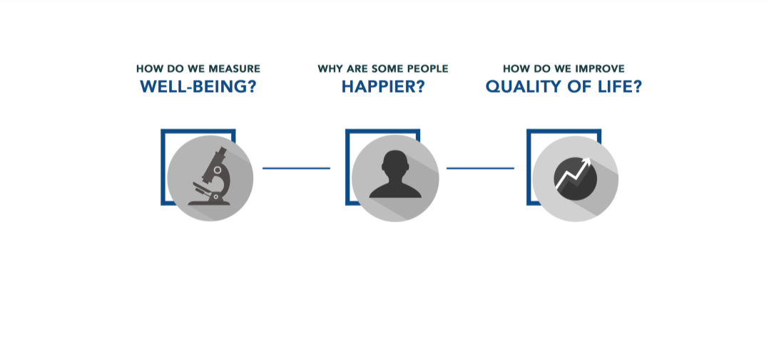

Slide 5
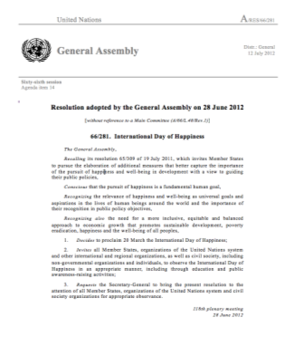
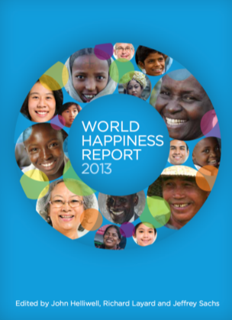
THE UNITED NATIONS
The United Nations Happiness Resolution
International Day of Happiness
UN World Happiness Report

Slide 6
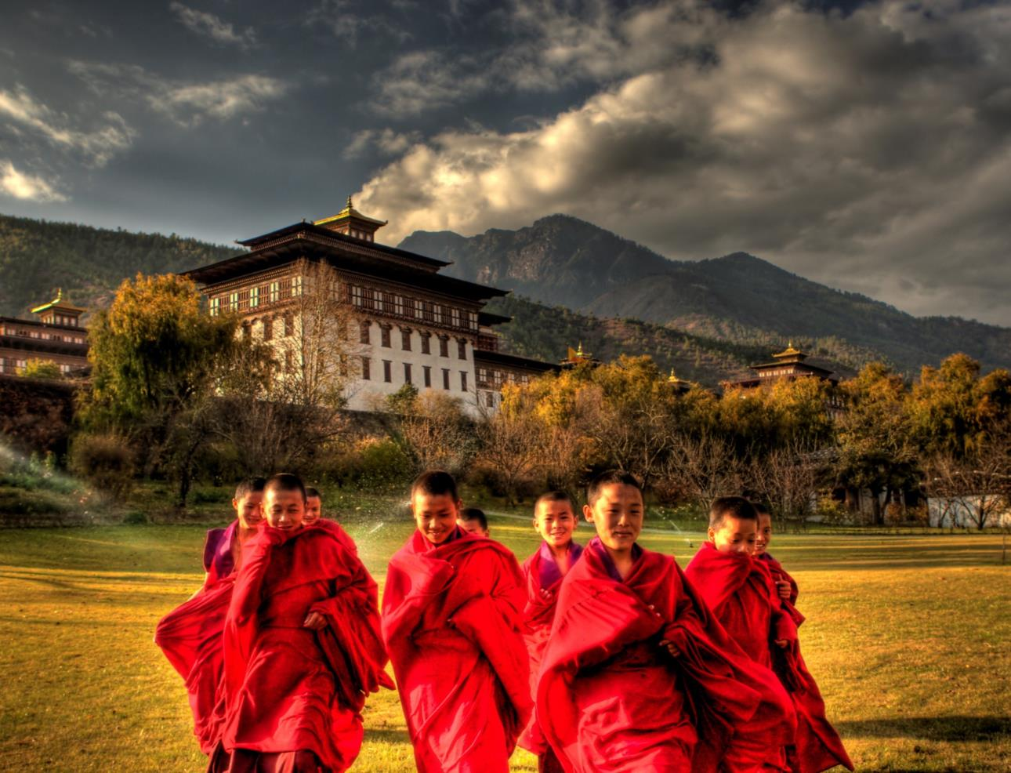

Slide 7
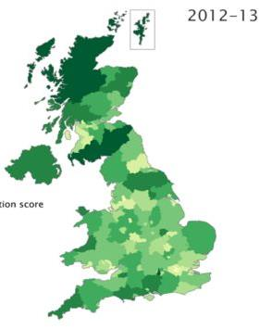
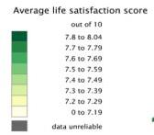
“We will start measuring our progress as a country, not just by how our economy is growing, but by how our lives are improving.
Not just by our standard of living, but by our quality of life.”
The Government of the UK

Slide 8
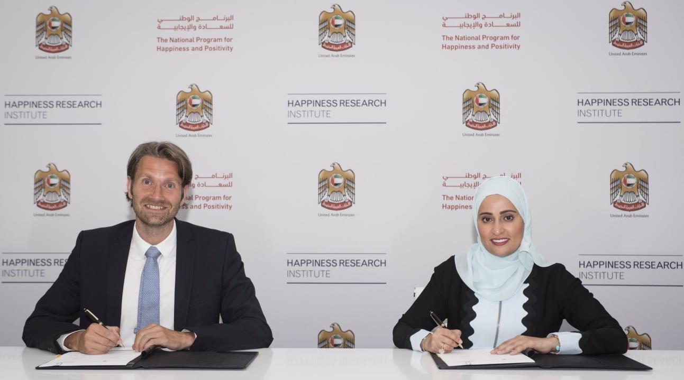

Slide 9
EGYPT BEFORE THE ARAB SPRING
Source: OECD Guidelines on Measuring Subjective Well-being, 2013

Slide 10
EGYPT BEFORE THE ARAB SPRING
Source: OECD Guidelines on Measuring Subjective Well-being, 2013

Slide 11
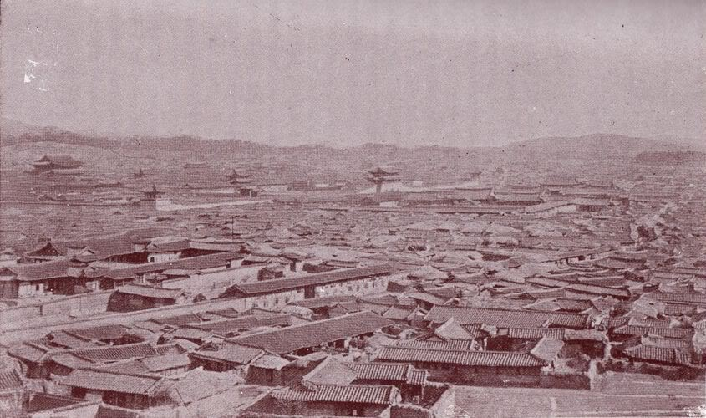

Slide 12
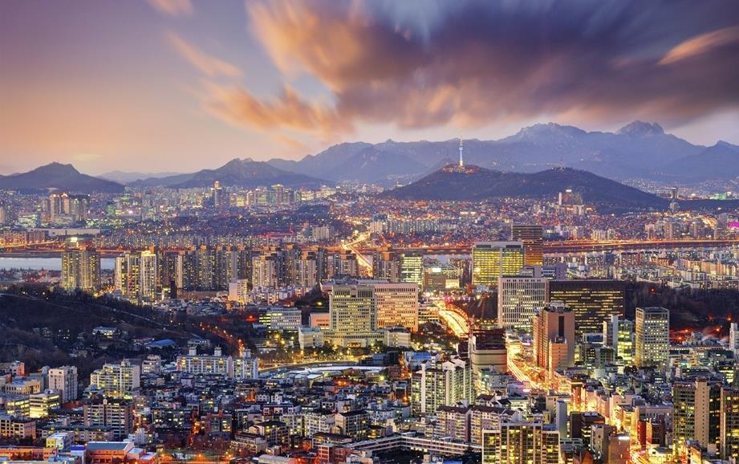

Slide 13
HOW CAN WE MEASURE HAPPINESS?

Slide 14
HAPPINESS
A mental or emotional state of well-being which can be defined by among others positive or pleasant emotions ranging from contentment to intense joy.

Slide 15
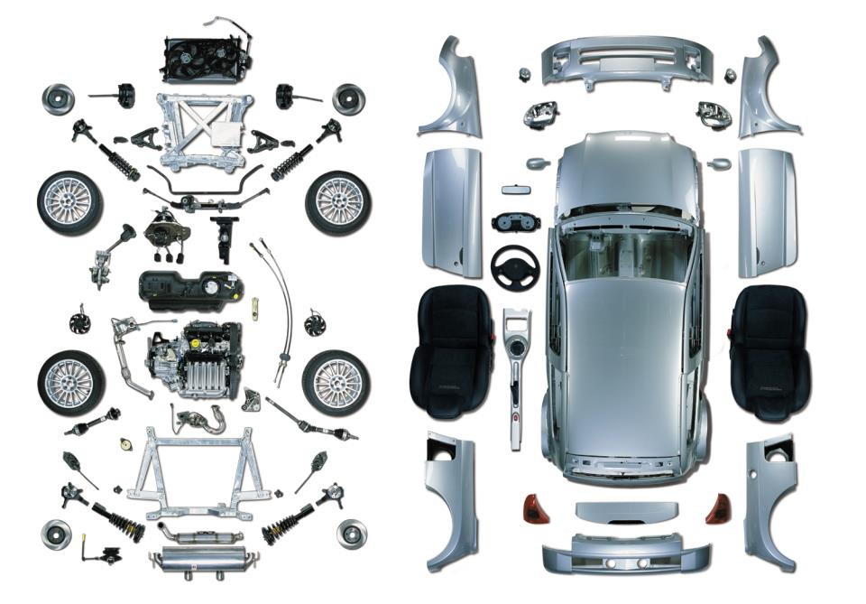

Slide 16
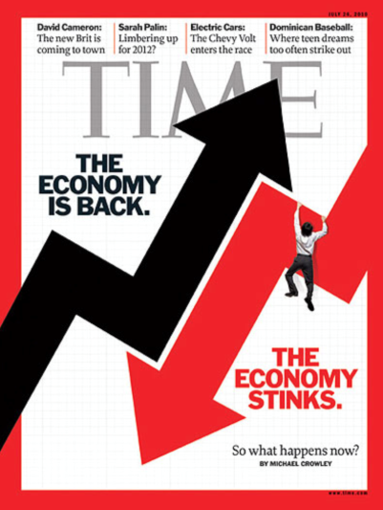
THE ECONOMY
A social domain that emphasizes the practices, discourses, and material expressions associated with the production, use, and management of resources.

Slide 17
Life evaluation – a reflective assessment on a person’s life or some specific aspect of it.
Affect – a person’s feelings or emotional states, typically measured with reference to a particular point in time.
Eudaimonia – a sense of meaning and purpose in life, or good psychological functioning

Slide 18
EFFECT OF UNEMPLOYMENT ON HAPPINESS
Source: British Household Panel

Slide 19
EFFECT OF MARRIAGE ON HAPPINESS
Source: British Household Panel

Slide 20
MEASURE WHAT MATTERS

Slide 21
WHY ARE THE NORDIC COUNTRIES DOING WELL IN HAPPINESS RANKINGS?

Slide 22
THE NORDIC COUNTRIES
WORLD HAPPINESS
REPORT 2012
DENMARK
FINLAND
NORWAY
NETHERLANDS
CANADA
SWITZERLAND
SWEDEN
NEW ZEALAND
AUSTRALIA
IRELAND
WORLD HAPPINESS
REPORT 2013
DENMARK
NORWAY
SWITZERLAND
NETHERLANDS
SWEDEN
CANADA
FINLAND
AUSTRIA
ICELAND
AUSTRALIA
WORLD HAPPINESS
REPORT 2015
SWITZERLAND
ICELAND
DENMARK
NORWAY
CANADA
FINLAND
NETHERLANDS
SWEDEN
NEW ZEALAND
AUSTRALIA
WORLD HAPPINESS
REPORT 2016
DENMARK
SWITZERLAND
ICELAND
NORWAY
FINLAND
CANADA
NETHERLANDS
NEW ZEALAND
AUSTRALIA
SWEDEN
WORLD HAPPINESS
REPORT 2017
NORWAY
DENMARK
ICELAND
SWITZERLAND
FINLAND
NETHERLANDS
CANADA
NEW ZEALAND
AUSTRALIA
SWEDEN
WORLD HAPPINESS
REPORT 2018
FINLAND
NORWAY
DENMARK
ICELAND
SWITZERLAND
NETHERLANDS
CANADA
NEW ZEALAND
SWEDEN
AUSTRALIA

Slide 23
75% OF THE
DIFFERENCES IN HAPPINESS
CAN BE EXPLAINED BY
6 FACTORS

Slide 24
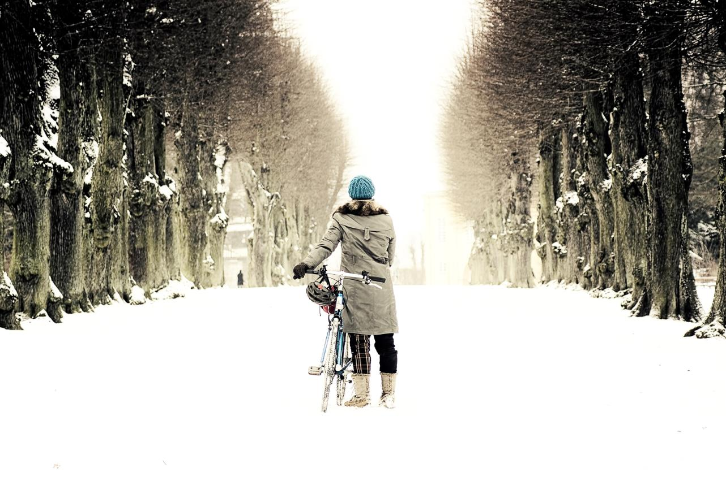
GDP PER CAPITA
HEALTH
TRUST
SOCIAL SUPPORT
FREEDOM
GENEROSITY
SOCIAL SUPPORT
HEALTH
MONEY
FREEDOM
TRUST
KINDNESS

Slide 27
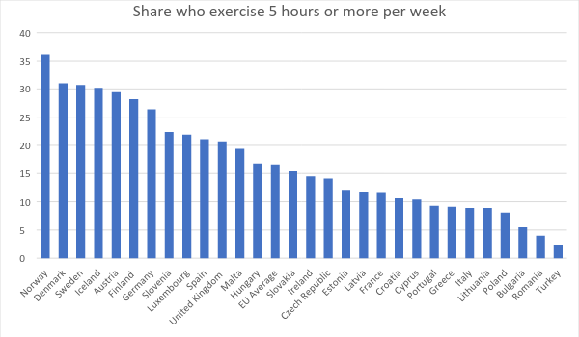
Source: European Social Survey
HEALTH
SHARE WHO EXERCISE MORE THAN FIVE HOURS PER WEEK

Slide 28
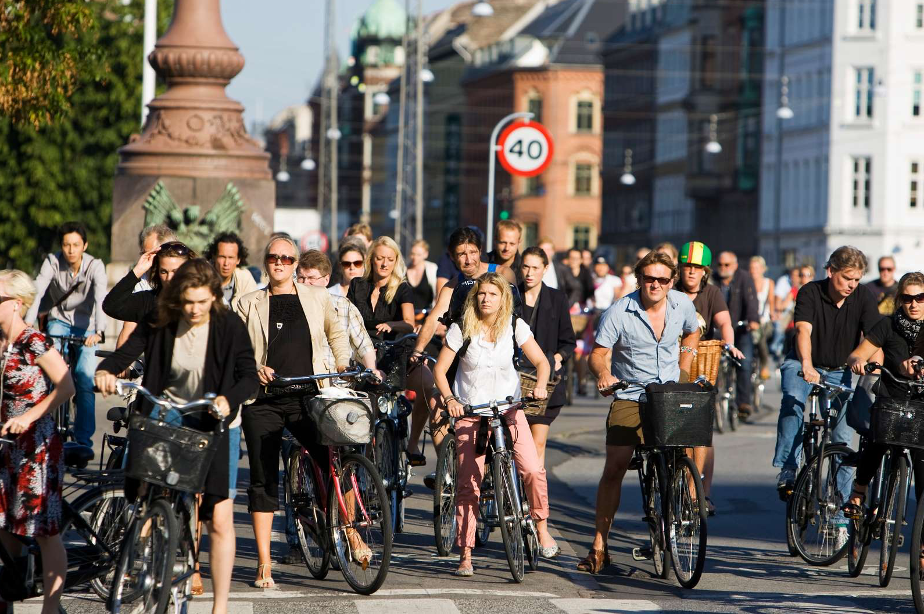
9 out of 10 Danes own a bicycle
75 per cent of cyclists bike all year round
There are five times as many bikes as cars in Copenhagen
63 per cent of all members of the Danish Parliament bike to work daily
58 per cent of children cycle to school in Copenhagen
17 per cent of all families with kids have a cargo bike

Slide 29
PERCENTAGE OF PEOPLE EXPRESSING A HIGH LEVEL OF TRUST
Source: OECD Society at a glance – social indicators, 2011

Slide 30
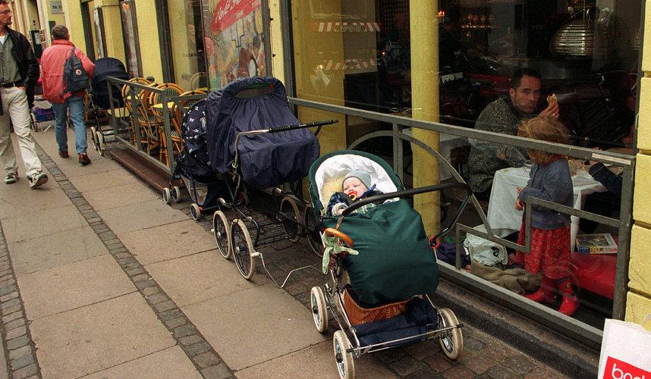

Slide 32
Helsinki 92% Mumbai 75% Budapest 67% New York 67% Moscow 58% Amsterdam 58% Berlin 50% Ljubljana 50% London 42% Warsaw 42% Bucharest 33% Rio de Janeiro 33% Zurich 33% Prague 25% Madrid 17% Lisbon 8%

Slide 33
GDP PER CAPITA
HEALTH
TRUST
SOCIAL SUPPORT
FREEDOM
GENEROSITY
SOCIAL SUPPORT
HEALTH
MONEY
FREEDOM
TRUST
KINDNESS

Slide 34
HOW DO WE APPLY HAPPINESS RESEARCH IN PRACTICE?

Slide 35
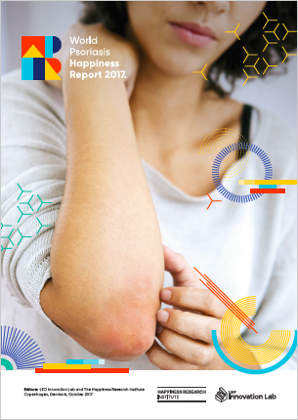
CASE: Patient group
People living with psoriasis
150,000+ completed surveys
The “happiness gap”
¨

Slide 36
Happiness inequality
The happiness gap varies between countries
USA
Average 7.1
Pso 5.7
Gap 1.4
21% less happy
France
Average 6.4
Pso 5.5
Gap 0.9
16% less happy

Slide 37
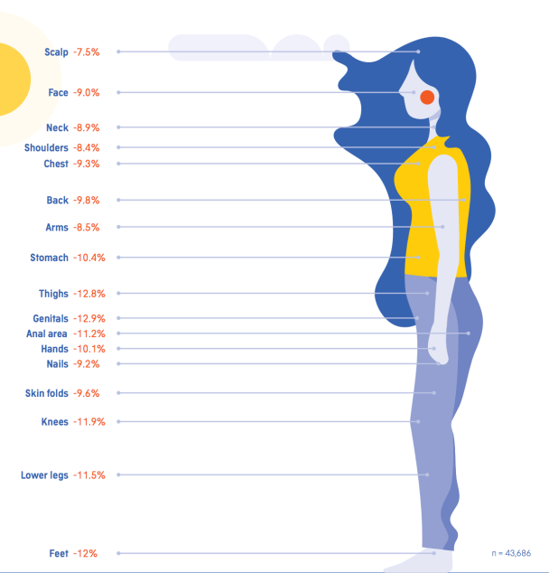
Psoriasis on different body parts causes different happiness gaps

Slide 38
CASE: The Nordea Foundation
427 Young people
Studied over two years
What factors to focus on?

Slide 39
Satisfaction with life
Year 0

Slide 40
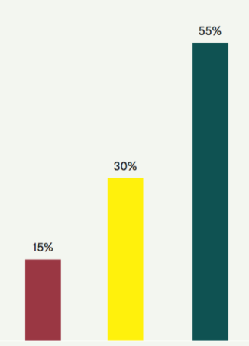
Year 2
55% experienced an increase in life satisfaction
15% had a decrease in life satisfaction
The average effect +12%

Slide 41
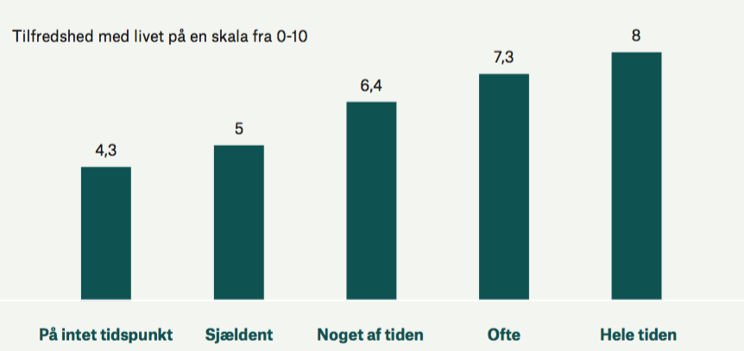
Satisfaction with life
Self confidence
Low confidence High confidence

Slide 42
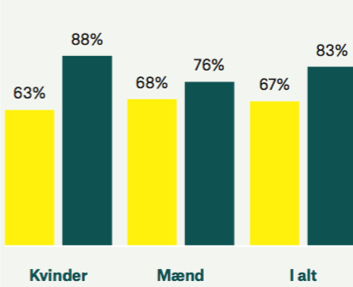
Feeling
recognized
Women Men Total
Year 0
Year 2
Year 0
Year 2
Year 0
Year 2

Slide 43
Thank you for your attention.
@MeikWiking
Meik Wiking
wiking@happinessresearchinstitute.com

